Slide 1

Project Cost Management

Slide 2
What is Cost and Project Cost Management?
Cost is a resource sacrificed to achieve a specific objective or something given up in exchange
  Costs are usually measured in monetary units like birr, dollar, etc
Project cost management includes the processes required to ensure that the project is completed within an approved budget.
Project managers must sure the projects are well defined, have accurate time and cost estimates and have a realistic budget that they were involved in approving

Slide 3
The Importance of Project Cost Management
IT/SW projects have a poor track record for meeting budget goals
The CHAOS studies found the average cost overrun (the additional percentage or dollar amount by which actual costs exceed estimates) ranged from 180 percent in 1994 to 43 percent in 2002; other studies found overruns to be 33-34 percent

Slide 4
Reasons for Cost Overruns
Not emphasizing the importance of realistic project cost estimates from the outset.
  Many of the original cost estimates for IT/SW/IS projects are low to begin with and based on very unclear project requirements
Many IT professionals think preparing cost estimates is a job for accountants when in fact it is the same demanding and important skill that project managers need to acquire.
Many IT projects involve new technology which involve untested products that leads to risks.

Slide 5
Basic Principles of Cost Management
Profits are revenues minus expenses
Life cycle costing is estimating the cost of a project over its entire life.
Cash flow analysis is determining the estimated annual costs and benefits for a project.
Sunk cost are retrospective (past) costs that have already been incurred and cannot be recovered.
  Should not be a criteria in project selection

Slide 6
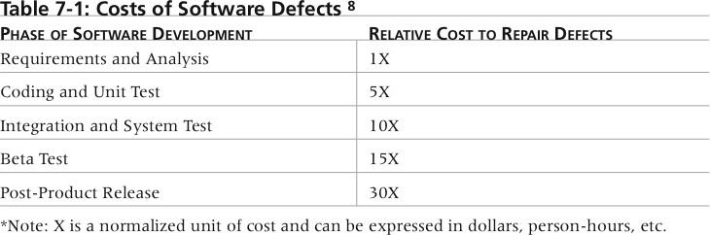
Cost of Software Defects
So, it is better to spend money on defining user requirements and doing early testing on IT projects than after implementation.
  If it would cost $1,000 to repair a software defect in the requirements and analysis phase but it would cost $30,000 to fix it in the post-product release phase

Slide 7
Project Cost Management Processes
Plan cost management
Cost estimating
Cost budgeting
Cost control

Slide 8
Plan Cost Management
Cost management plan is the process that establishes the policies , procedures ,and documentation for planning , managing, expending, and controlling project costs.
Different associated tools and techniques are also documented in this plan( component of PM plan).
It is also important to develop a cost management plan that describes how cost variances will be managed on the project.

Slide 9
Cost Estimating
It is the process of developing an estimate of costs or resources needed to complete a project work.
An important output of project cost management is a cost estimate by using estimation tools and techniques.

Slide 10
Types of Cost Estimates
A ROM estimate that actually cost $100,000 would range between $75,000 to $175,000.
A budgetary estimate that actually costs $100,000 would range between $90,000 to $125,000.
A definitive estimate that actually costs $ 100,000 would rang between $95,000 to $110,000.

Slide 11
Cost Estimation Tools and Techniques
3 basic tools and techniques for cost estimates:
  Analogous or top-down: use the actual cost of a previous, similar project as the basis for the new estimate
  Bottom-up: estimate individual work items and sum them to get a total estimate.
  Parametric: use project characteristics in a mathematical model to estimate costs.

Slide 12
Constructive Cost Model (COCOMO)
Barry Boehm, develop the COCOMO models for estimating software development costs.
Parameters include source lines of code or function…..
COCOMO II is a computerized model available on the web
Boehm suggest that only parametric models do not suffer from the limits of human decision-making.
COCOMO link

Slide 13
Typical Problems with Cost Estimates
Developing an estimate for a large software project is a complex task requiring a significant amount of effort. Remember that estimates are done at various stages of the project
Many people doing estimates have little experience doing them. Try to provide training and mentoring
People have a bias toward underestimation. Review estimates and ask important questions to make sure estimates are not biased
Management wants a number for a bid, not a real estimate. Project managers must negotiate with project sponsors to create realistic cost estimates

Slide 14
Cost Budgeting
Cost budget involves allocating project cost estimate to individual work items and providing a cost baseline for performance measures.
For example, in Business Systems Replacement project, there was a total purchased costs estimate for FY97 of $600,000 and another $1.2 million for Information Services and Technology.

Slide 15
Cost Control
It means controlling changes to the project budget.
The process of monitoring status of project to update project costs and managing changes to project cost baseline.
Project cost control includes
  Monitoring cost performance/G/E
  Ensuring that only appropriate project changes are included in a revised cost baseline.
  Informing project stakeholders of authorized changes to the project that will affect costs.
Earned value management is an important tool for cost control.

Slide 16
Earned Value Management (EVM)
EVM is a project performance measurement technique that integrates scope, time, and cost data.
Given a baseline (original plan plus approved changes), you can determine how well the project is meeting its goals.

Slide 17
Earned Value Management Terms
Planned value (PV), formerly called the budgeted cost of work scheduled (BCWS), also called the budget, is that portion of the approved total cost estimate planned to be spent on an activity during a given period
Actual cost (AC), formerly called actual cost of work performed (ACWP), is the total of direct and indirect costs incurred in accomplishing work on an activity during a given period
Earned value (EV), formerly called the budgeted cost of work performed (BCWP), is the percentage of work actually completed multiplied by the planned value

Slide 18
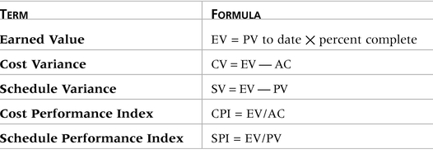
Earned Value Formulas
To estimate what it will cost to complete a project or how long it will take based on performance to date, divide the budgeted cost or time by the appropriate index.

Slide 19
Rules of Thumb for EVA Numbers
Negative numbers(<0) for cost and schedule variance indicate problems in those areas. The project is costing more than planned or taking longer than planned
CPI and SPI > 1.0 indicate exceptional performance
CPI and SPI < 1.0 indicate poor performance

Slide 20
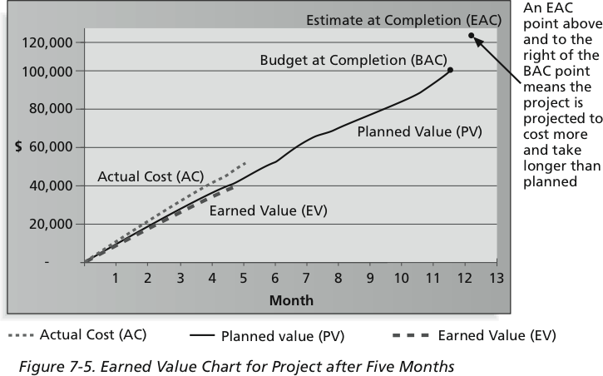
Earned Value Chart for Project After Five Months
EAC = $122,308 = BAC/CPI = $100,000/.81761
ETC = 12.74 months = Original Time Estimate/SPI = 12 months/.94203
If EV line is below PV line, it shows poor performance.

Slide 21
Example
Suppose you have a budgeted cost of a project at Birr 900,000. The project is to be completed in 9 months. After a month, you have completed 10 percent of the project at a total expense of Birr 100,000. The planned completion should have been 15 percent.
  Given:
    PV to date = Birr 900,000
    AC = Birr 100,000

Slide 22
…solution
Earned Value = Percent Completed (%) * Planned Valued to date
= 10% * Birr 900,000
= Birr 90,000

Slide 23
…continued
CV = EV – AC
= 90,000 – 100,000
= -10,000
SV = EV – PV
= 90,000 – 900,000
= - 810,000
The project is costing more than planned and because CV is less than zero.
The project is taking longer than planned because SV is less than zero.

Slide 24
…continued
CPI= EV / AC
= $90,000 / $100,000
= 0.90
SPI= EV/PV
= 90,000 / 900,000
= 0.1
It shows Poor Performance because CV and SV are less than one.

Slide 25
Group Assignment 15%
Q1. Assume you have a project to be completed in 12 months. Its budgeted cost is Birr 2,000,000. After 3 months, you have completed 18% of your project at a total cost of Birr 250,000. The planned completion should have been 20%.
EV
CV and SV
CPI and SPI
Is the project is costing more than planned, less than planned, or according to the planned? Why?
Is the project showing poor performance, exceptional performance, or it is performing according to the plan? Why?
Q2. Explain the differences between
  Direct and Indirect costs
  Tangible and Intangible benefits
  Mention examples for each of them

Slide 26
Group Assignment Cont..
Q3.Explain the differences between
  Direct and Indirect costs
  Tangible and Intangible benefits
  Mention examples for each of them
Q4. Write the process of project cost management. Take one specific project as an example and discuss about how to following project cost management.

Slide 27
Thanks

